Slide 1
SOA 2.0 – Standards & Guidelines
November - 2017

Slide 2
Table of Contents
SOA 2.0 – Technical Architecture Overview
SOA 2.0 - 12 Factor App Guidelines
SOA 2.0 - API Design Guidelines
SOA 2.0 - Microservices Design Guidelines
SOA 2.0 - Microservices Development Guidelines
SOA 2.0 - Microservices working with Legacy Systems (Anti-Corruption Layer)

Slide 3
SOA 2.0 Technical Architecture Overview
APIs & Microservices architecture overview

Slide 4
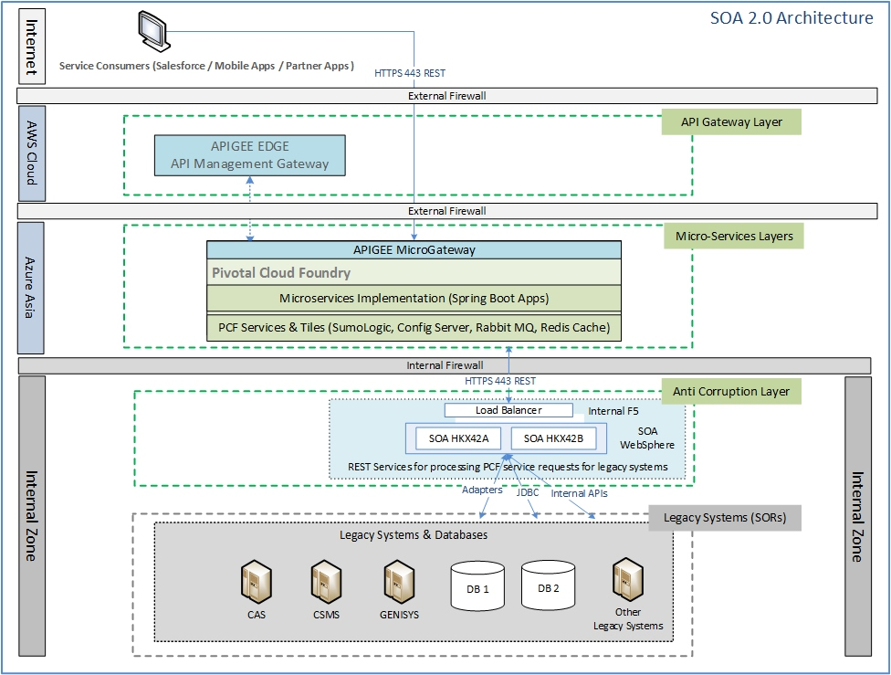
SOA 2.0 – Technical Architecture Overview (1/2)

Slide 5
SOA 2.0 – Technical Architecture Overview (2/2)
SOA 2.0 Reference Architecture is a layered architecture which provides clear demarcation between different layers involved (API Gateway Layer, Microservices Layer, Anti Corruption Layer and Legacy System Layer). It further highlights platform components, technical components and interaction across layers required to serve a consumer request.
API Gateway Layer
APIGEE API Micro-gateway sits on Pivotal Cloud platform and becomes the entry point for every new request coming from service consumers. The API request will be validated and delegated to appropriate Micorservice application. The APIGEE Micro-gateway will sync with APIGEE Edge Cloud platform for reading configurations and sharing operational metrics. API Gateway & Management Layer would be responsible for handling API Versioning, Authentication, Authorization, Traffic Management, Logging, Orchestration, Choreography etc.
Microservices Layer
Pivotal Cloud Foundry acts as the Microservice layer. All the managed services and custom developed application micro services runs in this layer. In case of any interaction required with backend source systems it would use the REST / SOAP services in case its available else would go through the Anti Corruption Layer for interaction with the source systems / database.
Anti Corruption Layer
The anti-corruption layer translates the service request to legacy format and vice-versa so that the micro services remain decoupled and exclude any complexities while interfacing with legacy systems. This layer will also provide data synchronization services for implementing eventual consistency.
Legacy Systems / SOR Layer
Legacy Systems layer comprises of the core applications (System Of Records) and databases. In order to minimize the dependency on IIB, all existing SOAP services will be eventually migrated / rewritten to PCF platform as microservices.

Slide 6
12 Factor App Guidelines and Beyond
Principle and Guidelines to be followed by Cloud Native Apps & Microservices

Slide 7
SOA 2.0 – 12 Factor App Guidelines and More
12 Factor Apps are guidelines published in 2012 by a team at HEROKU. The objective of these 12 factors is to guide developers about how to build cloud ready applications using declarative formats for automated setups, have clean contracts and were able to scale dynamically. We have documented all these factors in PCF context. Each section of the document contains -
Brief overview about the factor
Detailed Description explaining the benefits, anti-patterns or violation scenario’s and key takeaways
Provides pointers on how PCF platform enables / supports this factor
12 Factors | Summary Description
Codebase | One codebase tracked in revision control. Many Deploys
Dependencies | Explicitly declare and isolate dependencies
Configurations | Externalize application configurations and store them in the environment
Backing Services | Consider backing services as attached resources
Build, Release, Run | Build, Release and Run stages should be strictly separated and mutually exclusive
Processes | Execute the application as one or more stateless processes
Port Binding | Export services via port binding
Concurrency | Scale out via the process model
Disposability | Maximize robustness by fast start up and graceful shutdown
Dev / Prod Parity | Keep Development, Staging and Production regions as similar as possible
Logs | Consider logs as event streams
Administrative Processes | Run admin processes & management tasks as one-off processes
Beyond 12 Factors | Summary Description
API Frist Design | Follow API First Design approach while designing applications
Telemetry | Apps & services deployed over cloud should be continuously monitored
Security First Design | Security should never be an afterthought.

Slide 8
SOA 2.0 – 12 Factor Apps – Value Proposition in PCF Context
S No | 12 Factors | Value Proposition
1 | One Codebase One App | Time to Market → use good SDLC practices for quick delivery & deployment
2 | Dependency Management | Dev Productivity → Standardize and simplify to avoid last minute surprises
3 | Configurations | Release Management best practices → Move configurations to environment VARS
4 | Backing Services | Resilience / Agility → maintain loose binding
5 | Build, Release, Run | Release Management best practices → make use of CI / CD automation
6 | Stateless Processes | Cloud Platform Compatibility → Move state information to backing services
7 | Port Binding | Operational Efficiency → Use PCF features like routing, scaling etc.
8 | Concurrency | Auto-scaling → Design applications for cloud platforms. Use PCF features
9 | Disposability | Auto-scaling → Move slow executing processes to backing services
10 | Dev / Prod Parity | Reliability → use PCF (Cloud platform) offered environments
11 | Logs | Real-time Metrics → use PCF features (STDOUT / STDERR)
12 | Administrative Processes | Reliability → Move admin processes to backing services

Slide 9
API Design Guidelines
Designing Customer Centric Business APIs

Slide 10
SOA 2.0 – API Design Guidelines
The API Design Guidelines covers following key areas -
API Design Principles
Theses design principles offers a solid blueprint for doing the API Design
API Identification / Discovery
The API Identification model presents the strategy to consolidate the business services, coming up with candidate APIs list and finally arriving at Prioritized list of APIs for design and implementation. API discovery process leverages the decision matrix for selecting / prioritizing an API.
API Specification
API specification and documentation is very crucial aspect of API design. Open API Specification and Open API Meta Model are explained in detail for the team to set the standards for APIGEE API Documentation and Microservices documentation using Swagger

Slide 11
SOA 2.0 – API Design Overview
API stands for Application Programming Interface. There are many different types of APIs like Program-centric APIs (JARs / DLLs etc.), Web APIs (RPC style, SOAP based), and also the popularly used REST APIs. In Microservices context, we only deal with REST APIs.
REST is an architectural style which is primarily designed to work with HTTP protocol. Its core principle is to define named resources that can be manipulated using a small number of methods. The resources and methods are known as nouns and verbs of APIs. With the HTTP protocol, the resource names naturally map to URLs, and methods naturally map to HTTP methods GET, POST, PUT, DELETE etc.
Microservices design goal is to create a set of decoupled, self-contained, independent and small systems working together to realize a business process. In order to implement business functions / processes, it is important that Microservices are exposed as REST APIs so that they be interfaced in a loosely coupled manner.
REST APIs are in use even before Microservices concept is introduced to us. REST API design goal is to ensure that every object (resource) has a uniform interface which is exposed as HTTP endpoints. All requests for that object should always be made using the exposed API interface.
To summarize – Microservices and REST APIs works together but solve different problems and hence should be exclusively designed. Microservices design is usually driven by domain model (bounded context) whereas the API design considers many aspects including – user / customer experience, granularity and aggregation requirements, re-usability, functional coverage etc.

Slide 12
SOA 2.0 – API Design Principles
S No | API Design Principles
1 | API Design is an architectural concern that spans across business functions, product designs and service operations.
2 | Existing systems design needs to be re-looked through domain driven design lens in order to identify API boundaries and resources.
3 | While designing APIs, we first need to determine what resources it will offer and the bounded context it will serve to. Domain driven design concepts can be looked into to find out relevant business entities, entity relationships, possible state transitions, events and callbacks
4 | For API design - UI / App Developers are the real users. Principles of user-centric design also applies to APIs (simplicity, obviousness, fit-for-purpose etc.)
5 | APIs should be designed at the lowest practical level of granularity because it allows them to be re-used and combined in different ways to address consumer needs.
6 | API granularity can be determined by identifying key entities and then attempt to model their life cycle. One API operation for each entity life cycle state transition is recommended.
7 | There should be only one API function for one business outcome (e.g. change of address).
8 | Microservices APIs can be combined / aggregated for creating customer facing experience APIs.
9 | When a service API is being integrated (aggregated) with another service then it’s important to ensure that the aggregated API covers full life cycle of a business process. Failure to do so would seriously impact user experience, because users would need to make multiple calls (which may result in managing lifecycle states) to complete the business process.
10 | Consumer centric APIs should offer complete business transaction as offered by websites / UI Apps
11 | API design should be technology agnostic and must adhere to Industry standards like Open API
12 | Graceful handling of error conditions is an essential element of API Design. Error messages should be delivered in human-readable format that can be easily understood by end user.
13 | Error messages should also include runtime diagnostics and other technical details for UI / App Developers and Administrators reference.
14 | API availability must be aligned and equivalent to the availability of the websites / UI Apps.
15 | Changes to APIs must always be deployed as fully backwards compatible upgrades. If they are not backward compatible, the old API version must be maintained alongside the new version for an appropriate period to allow all consumers to transition.
16 | The level of security required for a specific API depends on a risk assessment. Every API should specify its own risk assurance level and then enforce the needful security practices.
17 | Every API must be discoverable and documented. Good API documentation is the single most important quality that UI / App Developers look forward to.
18 | The API documentation should be published and a link to the documentation should be provided from the API endpoint.

Slide 13
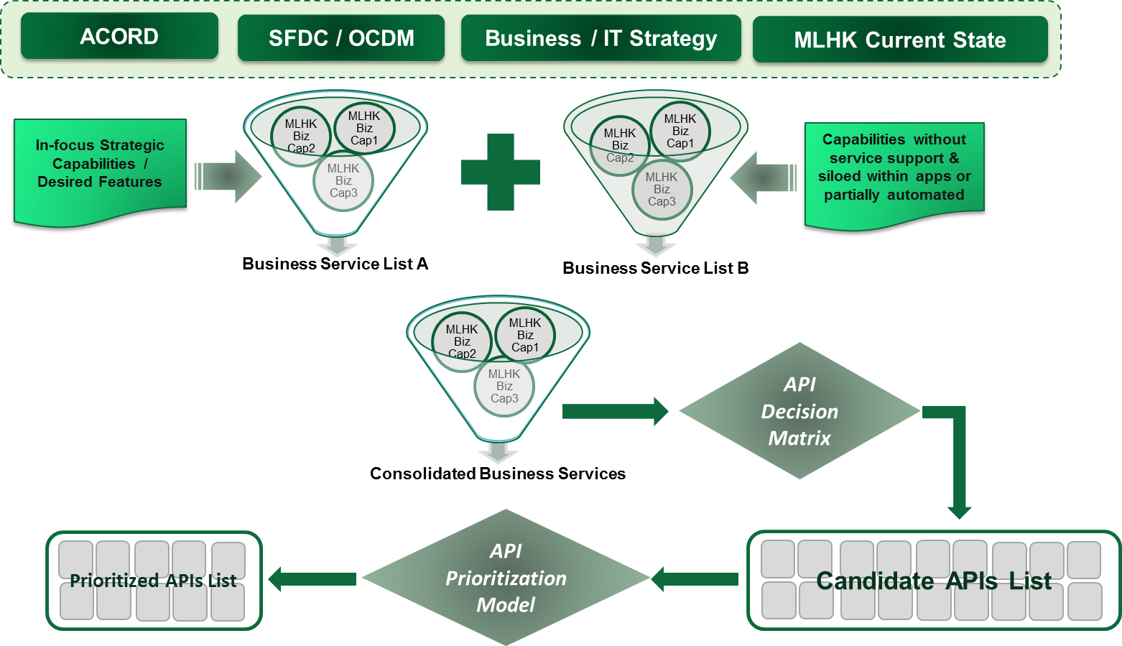
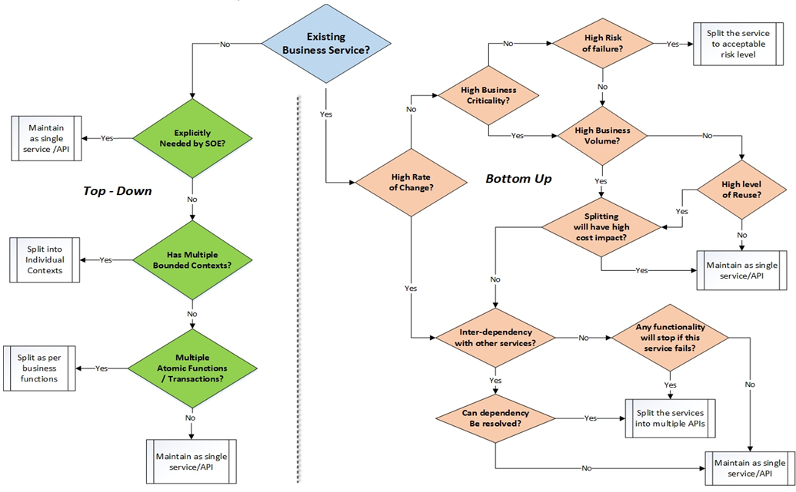
SOA 2.0 – API Identification Model
Consolidated Business Services derived from previous SOA assessment exercise has been reviewed and updated as per latest inputs received.
Candidate Business APIs have been identified from revised Business Services list following a Top – Down approach. Total 180+ APIs identified.
Candidate Business APIs list will be evaluated using API Decision matrix following a Bottom-up approach. Post this exercise, approx. 100+ APIs will be finalized.
Finalized list of APIs will undergo prioritization process based on the inputs from ML HK Business and IT groups.

Slide 14
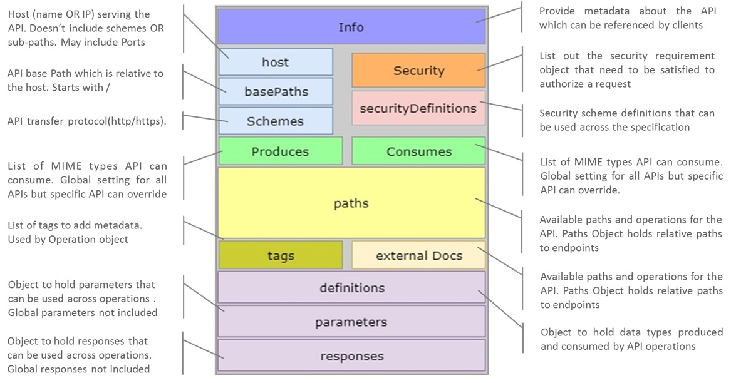
SOA 2.0 – API Design Specifications

Slide 15
SOA 2.0 – API Versioning Best Practices
In Manulife context, an API usually represents an interface for back-end services. Until there is a change in the interface contract, we don’t need a new API version. On the other side, a back-end service need to undergo frequent code changes and hence need to have frequent versioning requirement. Therefore, we can have different strategies for versioning APIs and back-end (micro)services
API Versioning Best Practices:
Make the version attribute mandatory while designing API specifications.
Specify the version with a 'v' prefix in the left side of the URL so that it has highest scope (e.g. /v1/products).
Use a simple ordinal number like v1, v2, etc. It is not recommended to use the dot notation like v1.2 because it implies a granularity of versioning that is not applicable for APIs.

Slide 16
SOA 2.0 – Possible API Versioning Approaches
One of the key objective of API versioning is to ensure that all internal and partner Apps are using the right version of APIs as per there requirement. Below mentioned are possible API versioning approaches -
Backend Service supports multiple versions and APIGEE do a simple pass through
Back-end services supports multiple versions and APIGEE just pass them through. This is the most simplest approach to follow as we end up following same versioning strategy everywhere. But, it has certain limitations.
APIGEE follows its own API versioning method and routes the request to appropriate Back-end service version
Here, we will follow different versioning strategies for APIs and back-end services. APIGEE will route the request to the right back-end service version. Request routing can be done based on parameters like URL/Query Parameters/ Headers/Schema attributes etc.
Backend Services supports only single version and APIGEE will do the mediation
Here, APIGEE will enforce API versioning and mediate the request/responses such that the backend gets the request in a way it understands, and the clients get the response in the way they expect. This is not a popular approach and is feasible only when the mediation rules are straightforward (and simple).
APIGEE sends an error response against the request for older API versions
In case we only want to maintain the most latest version for APIs (single versioning), this approach can be followed.
On receiving such API requests, APIGEE can give a (meaningful) error response to the clients informing them about the latest API version.

Slide 17
Microservice Design Guidelines
Principles and guidelines to be considered while designing micro services

Slide 18
SOA 2.0 – Microservice Design Guidelines
The Microservice Design Guidelines explains in details the characteristics, core principles, architecture, patterns and points to be considered while designing micro services
Microservices Characteristics
Microservices Design Principles
Microservices Reference Architecture Outer and Inner Views
Microservices Design Considerations
Microservices Design Patterns

Slide 19
SOA 2.0 – Microservice Characteristics
Characteristics | Description
Build around business capabilities | Microservices are designed to represent business capabilities instead of technology layers.
Componentization as a Service | Microservices are independently deployable components. Changes made in one service will not propagate to whole application / product
Elasticity | A microservice must be able to scale up OR down independent of other services in the same application / product.
Resilient | A microservice must fail without impacting other services. Failure of a single service instance should not have cascading impact on application / product.
Smart Endpoints & Web Scale Pipes | While interfacing with other services, a microservice owns domain & process flow logic. Integration / messaging platform will provide communication channels at web scale.
Composable | A microservices must offer granular interface that is uniform and is designed to support service composition
Evolutionary Design | Microservices are designed around bounded context which will allow service evolution at more granular level thus making it highly cohesive.
Decentralized Data Management | Microservices persist and manage their own data. Every service can use different data storage mechanism

Slide 20
SOA 2.0 – Microservice Design Principles
Design Principles | Description
Consumer Focus | Always consider consumer’s experience while making design and implementation decisions. The consumer includes end customer as well as internal users & systems.
Start Simple and then iterate to address complexity | Start with breaking your existing systems into mini – monoliths. In every iteration, ensure to have a working functional code and then iterate further to improve it by splitting to next level of granularity.
Follow API Frist Design | Follow top – down approach to identify candidate APIs for each Business Unit. Also perform bottom – up analysis to discover candidate APIs from existing systems. Discuss with Business and IT stakeholders to finalize and prioritize the APIs implementation. API design is very critical as it directly impacts the customer experience. Hence perform API design as the first design activity. Make use of Swagger / Open API standards for API design specifications.
Keep Evolving | Build a microservices platform which enables to introduce new features without taking down the service. Start with setup and configuration of basic support functions like – Deployment environment setup, Config Server, Service Registry, Log consolidation etc. As next step, configure PCF platform to provide backing services like – API Gateway, DB, Data Stores, message broker, In-Memory cache etc. Finally, perform needful steps on PCF platform to enable operational analytics and dashboard functions.
Automation is the Key | Follow DevOps culture to automate service implementation lifecycle. This will reduce human error thus improving reliability and consistency. Start with automation of basic DevOps activities like packaging and build generation, code quality checks and deployment in DEV region to perform smoke testing. As next step, setup and configure Continuous Integration pipeline automating all CI activities. As next step, setup and configure Continuous Delivery pipeline automating the delivery / deployment of service artefacts on PCF.

Slide 21
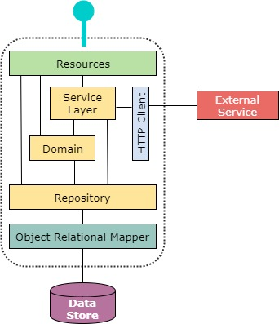
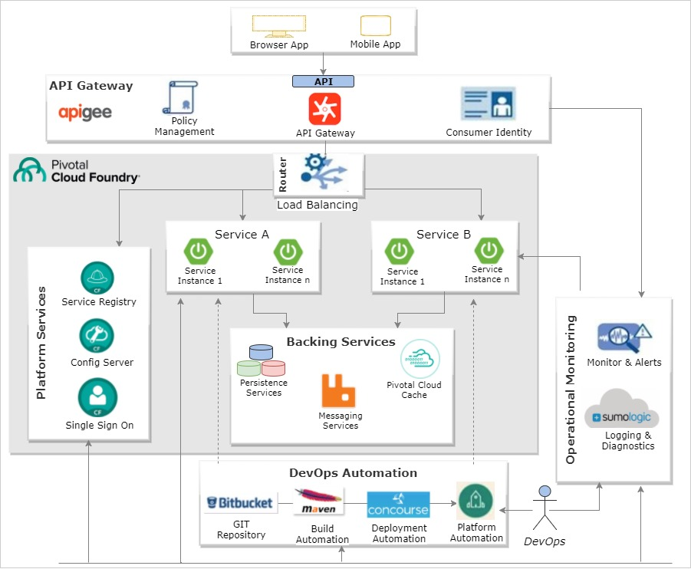
SOA 2.0 – Microservice Inner vs Outer Views

Slide 22
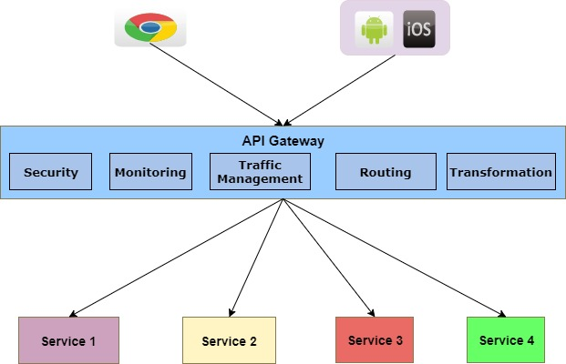
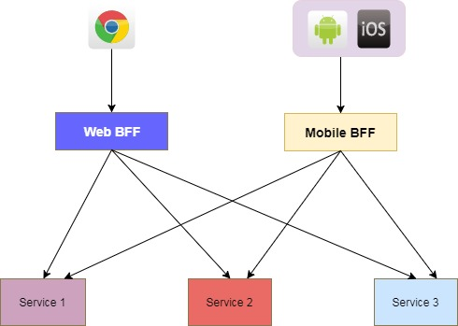
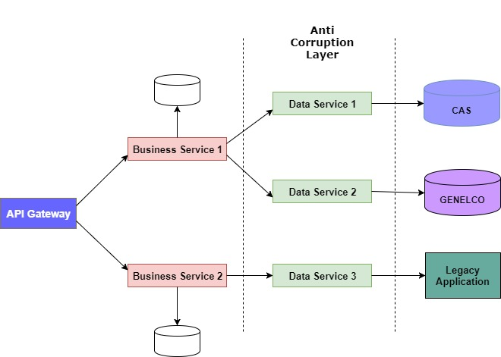
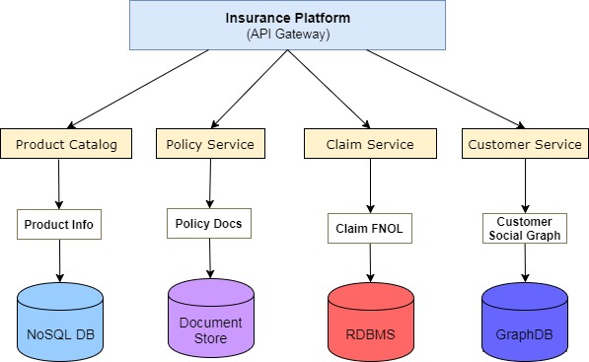
SOA 2.0 – Microservices Design Patterns (1/2)
API Gateway
Back-End For Front-End
Anti – Corruption Layer
Polyglot Persistence

Slide 23
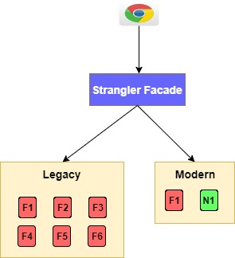
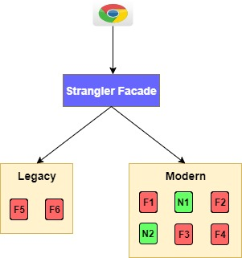
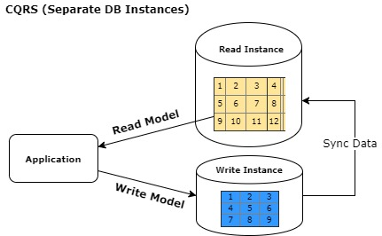
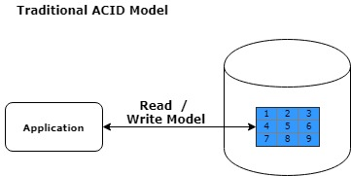
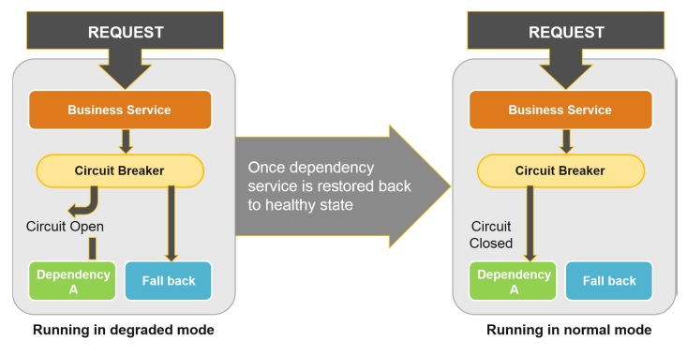
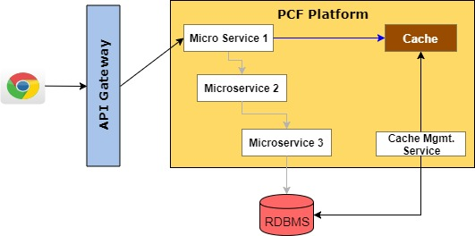
SOA 2.0 – Microservices Design Patterns (2/2)
Strangler
(CQRS) - Command Query Responsibility Segregation
Circuit Breaker
Near Cache

Slide 24
Microservice Development Guidelines
Principle and Guidelines to be followed while developing micro services

Slide 25
SOA 2.0 – Microservice Development Guidelines (Cookbook)
Microservices development guidelines document contains around 28 topics which helps the developers and designers quickly understand microservices basics and jump start development, deployment and management of service. This helps the developers to familiarize themselves with microservices concepts, best practices, design and standardize the approach for specific scenario’s that frequently occur during implementation.
It takes a recipe driven approach covering all SDLC stages. Recipes are categorized into multiple sections as follows
Spring Boot Basics
Microservices Development
Testing
Build, Package & Deployment
Monitoring
Each topic contains the following sections -
Topic overview - explaining the problem or best practice
Prerequisites - that are required before proceeding to implementation
Detailed Description on why we need this and how this helps provides with crucial implementation notes along with code, configuration snippets
References - detailed documentation reference, source code repository reference if any
Next steps - guiding where to go from here and learn related concepts.

Slide 26
SOA 2.0 – Microservices Development Guidelines (1/3)
S No | Topic | Comments
1 | Spring Boot Web App Basics | Jump start spring boot based application development with a simple REST service in STS using the Spring Initializer web service
2 | Managing configurations | Standardize application configuration management and access in a uniform way across projects
3 | Decorating Java POJO using Lombok | Plugin project Lombok to reduce the code verbosity and repetitiveness by generating bytecode into class files as per the annotations
4 | Annotations based validations | Using JSR-303 (javax.validation) for annotation based validation to reduce lot of conditions and make the code concise and clean
5 | Application Logging Standardization | Standardization of logging and best practices to be followed while logging
6 | Exception Handling best practices | Generic exception handling strategy using RestControllerAdvice
7 | Accessing Datastore using JPA | Setting up Spring JPA started template to map objects to relational databases tables
8 | Accessing Datastore using JdbcTemplate | Using JdbcTemplate where Spring JPA would be an overkill and when the code deals with procedures only
9 | Standardize Service Request & Response and Error mechanism | Standardization of API Request, Response and Error Reporting mechanism

Slide 27
SOA 2.0 – Microservice Development Guidelines (2/3)
S No | Topic | Comments
10 | Externalize Configuration with Config Server | Externalize the configuration related parameters that varies between deployment environments (Dev, Test, Prod etc.) using Config Server
11 | Registering Services with Service Registry | Facilitating communication between services without hardcoding host or port details
12 | Load Balanced Client with Feign and Ribbon | Communicating with other services where service instances change dynamically as new instances are created or shutdown
13 | Fault Tolerant Services with Hystrix | Isolating service from dependency failures using Hysterix
14 | User provided Service Instance | Utilizing User provided Service Instance as the mechanism to deliver the credentials to services at runtime automatically
15 | Single Sign On | Securing the end points of the application and API using PCF SSO
16 | Generating Authorization Tokens | Different ways of generating Authorization tokens to enable developers test their secured services independently
17 | Messaging with RabbitMQ | Utilizing Spring AMQP to facilitate asynchronous communication between service using messages
18 | Working with Pivotal Cloud Cache | Creating PCC cluster and accessing the in-memory data store using Pivotal Gemfire client library

Slide 28
SOA 2.0 – Microservice Development Guidelines (3/3)
S No | Topic | Comments
19 | Working with Redis Cache | Utilizing Spring Data Redis Template and Jedis client to connect and access Redis to store and retrieve data from the Redis Cache
20 | Configuring APIGEE API Gateway | Configuring the API’s Proxy, Configuration of scopes, routes, Client Id and Client Secret in APIGEE
21 | Swagger Documentation best practice fro micro services | Swagger Annotations for generating service documentation
22 | Unit Testing Micro Services | Testing apps using Junit and Spring Boot support
23 | Mock Services with Mockito | Mocking objects and executing test cases using Mockito
24 | Manage project dependencies | Using Maven to manage version, manage dependencies and enforcing constraints, rules using Maven Enforcer plugin
25 | Deploying Micro Services to PCF (Local Development and Testing) | Deploying applications in PCF using PCF CLI (Local Development), PCF STS Plugin (Local Development)
26 | Deploying Micro Services to PCF (Using Concourse) | Deploying applications in PCF using Concourse
27 | Analyze Logs in Sumo Logic | Writing custom queries in Sumo Logic to analyze the logs, faults, application metrics, container metrics etc.
28 | Monitoring Apps with New Relic | Configuring the New Relic Instance and analyzing applications based on different sets of parameters

Slide 29
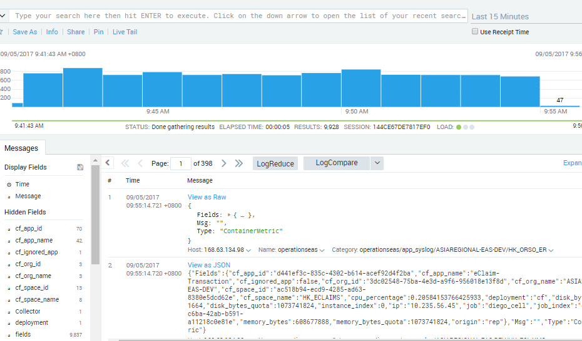
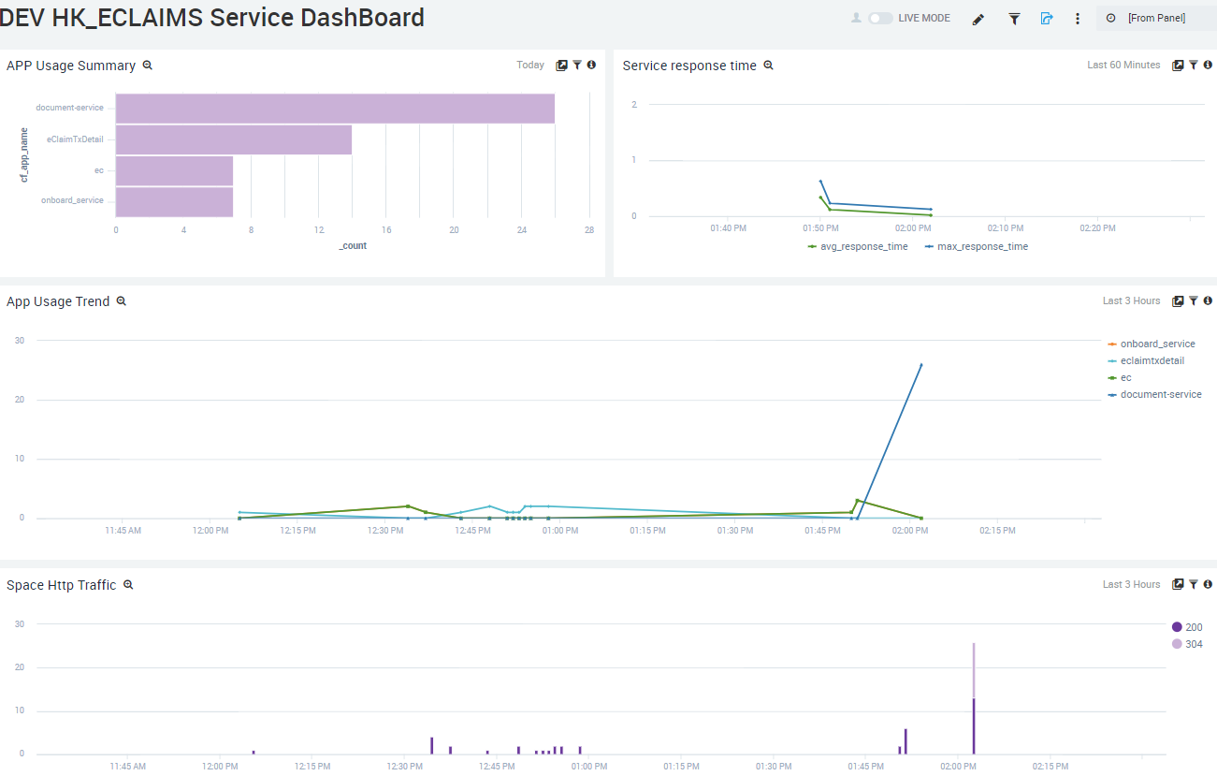
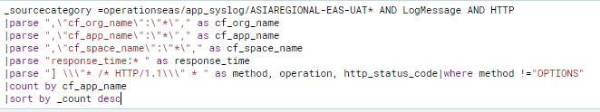
SOA 2.0 – Log Standardization & Analysis
Logging is a crucial aspect whether it’s a monolith or micro service based architecture. Especially when it comes to Microservices, multiple services interact with each other for completing a business process and there could be multiple service instances running in parallel.
The development cookbook explains the followings aspects with respect to Logging -
Log format and structure
Log Level and details to be logged
Request / Correlation Id
Changing log levels at runtime if required
Analyzing Logs for performance, faults and errors
Setting up notification mechanism
Visualize key parameters in Dashboard

Slide 30
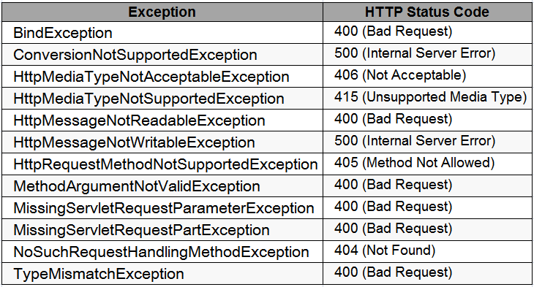
SOA 2.0 – Exception Handling and HTTP Status Response
This topic mainly focuses on handling HTTP exceptions and API Error response mechanism.
It provide details about -
Exceptions handling best practices
Exception handling using Rest Controller Advice
HTTP Response Status Codes to be handled
Code | Description | Comment
200 | Ok | Request processed successfully
201 | Created | Resource created, response contains reference to new resource
204 | No Content | Request processed successfully but has not resulted in new resource creation
304 | Not Modified | resource has not been modified since the version specified by the request headers
400 | Bad Request | Input s not as per expectation / data validations failed
401 | Unauthorized | Similar to 403 Forbidden, but specifically for use when authentication is required and has failed
403 | Forbidden | Need account or proper permission to access resource
404 | Not Found | Requested resource not found
405 | Method Not Allowed | Request method not supported
409 | Conflict | Edit conflict between multiple simultaneous updates
410 | Gone | Requested resource no longer available and will not be available again
415 | Unsupported Media Type | Request format not supported
500 | Internal Server Error | Backend Service / SQL / Queue / Cache / Unknown Application Error
503 | Service Unavailable | Service down or not available

Slide 31
Microservice Interaction with Legacy Systems / On Prem Databases
Anti Corruption Layer

Slide 32
SOA 2.0 – Microservice Interaction with Manulife HK Systems Of Records
Problem Statement
Cloud Native microservices & apps will be designed as per the OCDM - Manulife standard data model whereas The legacy systems will have there own data models. Since microservices need to access these legacy systems, any direct dependency will impact the apps & services design.
Recommended Solution
Recommended solution is to implement an Anti-Corruption layer for isolating microservices from legacy systems complexities.
Anti-Corruption layer – Key Responsibilities
Translate messages across services & legacy systems by mapping data attributes.
Host event driven data synchronization services for implementing eventual consistency across systems.
Anti Corruption Layer - Points to Consider
The new anti-corruption layer may add to latency
Additional ACL services needs to be maintained
Scaling of ACL services need to be considered at par with Cloud native apps & services.

Slide 33

Thank You

